Slide 1
HOLOGRAPHIC MEMORY
NEXT GENERATION STORAGE MEDIUM.

Slide 2
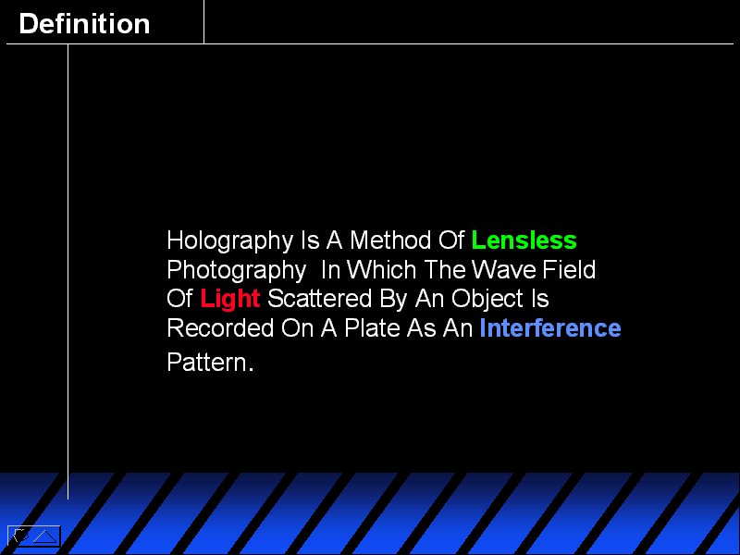

Slide 3
Introduction
Technique that stores information at:-
High density
Inside crystals or photopolymers
Uses the whole volume for storage

Slide 4
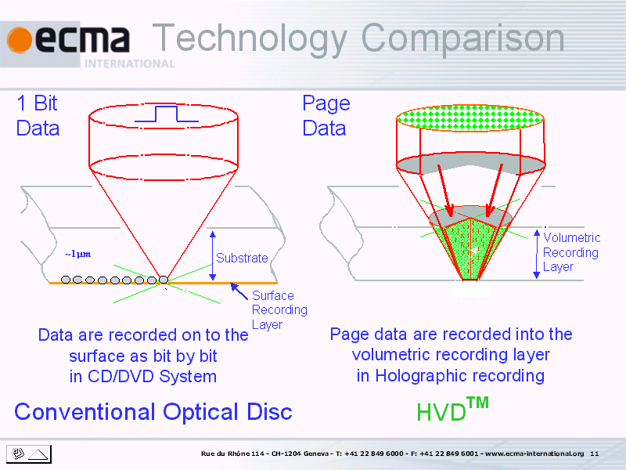

Slide 5
BASIC COMPONENTS
Blue-green argon laser
Beam-splitters
Mirrors to direct the laser beams
LCD panel(spatial light modulator)
Lenses to focus the laser beams
Lithium-niobate crystals or photopolymer
Charge –coupled device(CCD) camera

Slide 6
WORKING PRINCIPLE
Blue-green argon laser is fired.
Beam-splitter creates two beams.
One beam ,signal beam will go straight bounce off one mirror and travel through SLM.
SLM is a LCD that show pages of raw binary data.
The information from binary code is carried by signal beam around the light sensitive lithium –niobate crystal.
Second beam called the reference beam shoots out the side of the beam splitter and takes a separate path to the crystal.

Slide 7
Continued—
When the two beams meet the interference pattern that is created stores the data carried by signal beam.
This is a hologram.

Slide 8
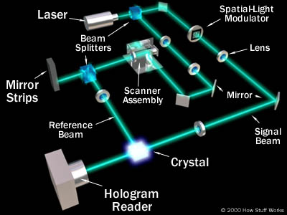
Design
Details about this topic
Supporting information and examples
How it relates to your audience

Slide 9
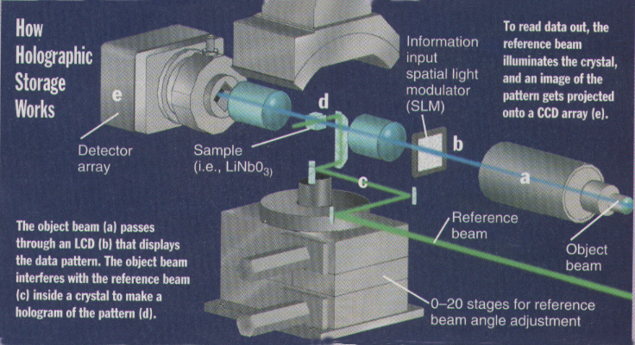
Topic Three
Details about this topic
Supporting information and examples
How it relates to your audience

Slide 10
A BRIEF BACKGROUND
More than 30 years of research and development. scientist Pieter J. van Heerden first proposed the idea of holographic (three-dimensional) storage in the early 1960s.
Early HDSS(desktop holographic storage system )had capacity of 125 GB and transfer rate of about 40 MB/sec.
When HDSS was first proposed the components for constructing was very expensive and large.
A CCD sensor was not available.
The researchers are quite confident that this technology would be widely used in some years.

Slide 11
Advance Technology
With such technologies we would be able to purchase the first holographic memory players by the time “star-wars : episode –II” is released on home 3D discs.
Its storage capacity is 27 times more than DVDs and transfer rate 25 times faster .
It will provide video professionals with an enterprise storage solution.

Slide 12
Comparision with DVD
DVD uses multiple layer to store information whereas the holographic memory uses the total volume to store data.
These DVD like discs have storage capacity 27 times greater than 4.7 GB DVDs available today.
Its transfer rate will be 25 times greater than the DVDs.

Slide 13
Continued---
It could load a whole DVD in just 30 secs.
It can store 1 TB of data with a data rate of 1GB/sec which is not possible with the DVD.
It can store 1000 CDs but DVDs doesnot hold such enormous capacities.

Slide 14
ADVANTAGE
Entire page of data can be retrieved quickly and at one time.
Offers storage of 1 TB of data in a sugar cube sized crystal.
It offers high density storage.
Its transfer rate is so high that a person can easily load the required data.

Slide 15
Continues--
Resistance to damage - If some parts of the medium are damaged, all information can still be obtained from other parts.
Efficient retrieval - All information can be retrieved from any part of the medium.

Slide 16
accurateness
In order to retrieve and reconstruct the holographic page of data stored in crystal the reference beam is shined into the crystal at exactly the same angle at which it is entered.
Each page of data is stored in different area of the crystal,based on the angle at which the reference beam strikes it.

Slide 17
Continues--
During reconstruction the beam will be diffracted by the crystal to allow the recreation of the original page.
The reconstructed page is then projected into the CCD camera which forwards digital information to computer.

Slide 18
sensitivity
The key component of any holographic data storage system is the angle at which the second reference beam is fired at the crystal.
It must match the original reference beam angle exactly.
Very minimal difference in angle will create error.

Slide 19
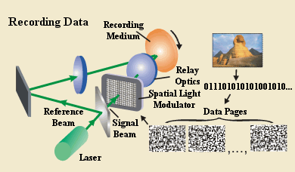

Slide 20
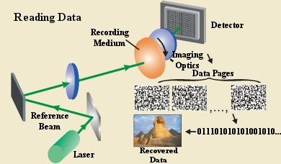

Slide 21
Application
It will provide video professional with an enterprise solution that will change the way they acquire,edit and archive high resolution video assets.
For broadcasting
For data-mining
For video editing because of data transfer rate of 1GB/sec.
Media management.

Slide 22





Slide 23
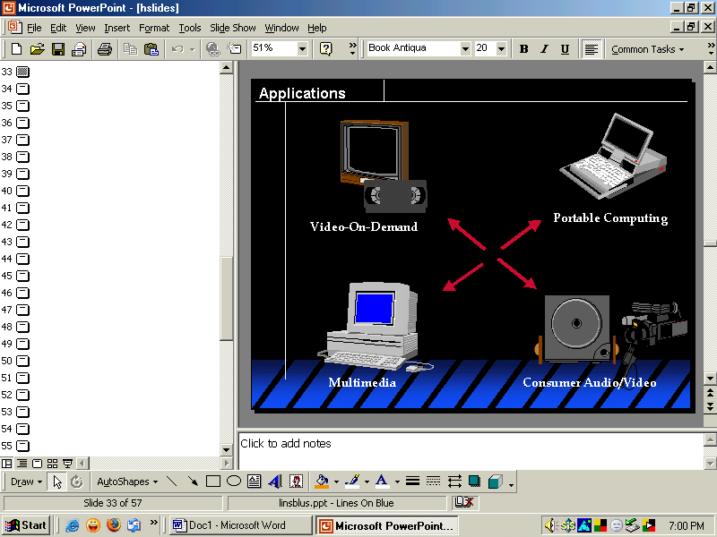

Slide 24
FUTURE
In order to increase the storage capability scientists are now working,on optical storage method ,called holographic memory.this would go beneath the surface and use the whole volume of recording medium for storage ,instead of only the surface area.

Slide 25
Imagine
A two hour movie on a video --the size of the credit card.
The entire encyclopedia Britannica—stored in a dime.
A device that can pack information 10 times more densely and fetch information 100 times more faster than any magnetic or optical disk.

Slide 26
Continue--
  Although HDSS components are easier to come by today than they were in the 1960s, there are still some technical problems that need to be worked out.
❖ Researchers are confident that technologies will be developed in the next two or three years to meet these challenges.

Slide 27
Conclusion
  This is idea is not new but it is gaining importance now.
  Almost the entire HDSS device can now be made from off-the-shelf components, which means that it could be mass-produced.
  It will be widely used within next few years.

Slide 28
THANK YOU

